Slide 1

Team 5
Team Members:
Jyoti Maske
Hiral Parekh
Yash Khamar
Neel Patel
-Online Retail Sales Analysis-
SENG8081-Case Studies

Slide 2

Slide Content :
Introduction
Problem & Solution
Data Research and Integration
Data Collection
Data Storage and Maintenance
Data Quality
Data Analysis and Visualisation
Devops
Future Enhancement
References

Slide 3
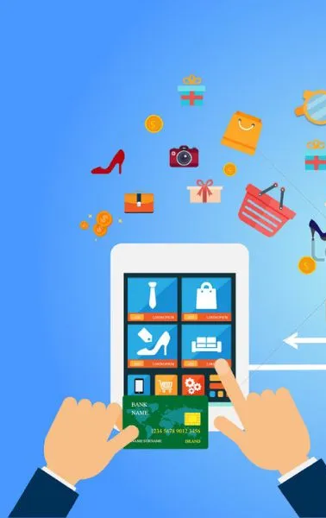
Introduction
Title: Online Retail Sales Analysis – Project Overview
This project is all about understanding online shopping trends using data.
We worked with real transaction data (from Kaggle) and enriched it with extra product info using FakeStore API to simulate metadata.
Our goal was to build a full pipeline: from collecting and cleaning data → storing in a database → to analyzing in Tableau/Power BI.
The final system helps track customer behavior, product popularity, and sales trends.
Tools: Python (ETL), SQL Server (Data Storage), Tableau (Visualization).

Slide 4
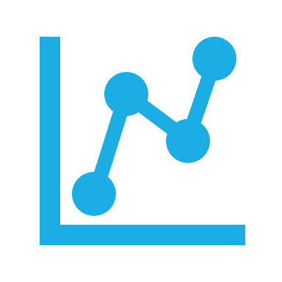
What problem is being solve?
The organization couldn’t make informed decisions due to messy, incomplete, and flat e-commerce data that lacked product details like brand, category, and rating.
This limited the ability to analyze sales, understand customers, or track product performance.

Slide 5
What were the key issues?
Missing product context (no brand/category/image)
Poor data quality (nulls, duplicates, invalid prices)
Flat file format not suitable for dashboards or analysis
Manual updates with no automation
No way to simulate real-time changes in product data

Slide 6
What solution did we arrive at?
We built an automated ETL pipeline that cleans Kaggle data, enriches all products using metadata from an external API, stores everything in a normalized SQL Server database, and connects it to Tableau for live dashboards.
A .bat script schedules the full process for regular refresh.

Slide 7
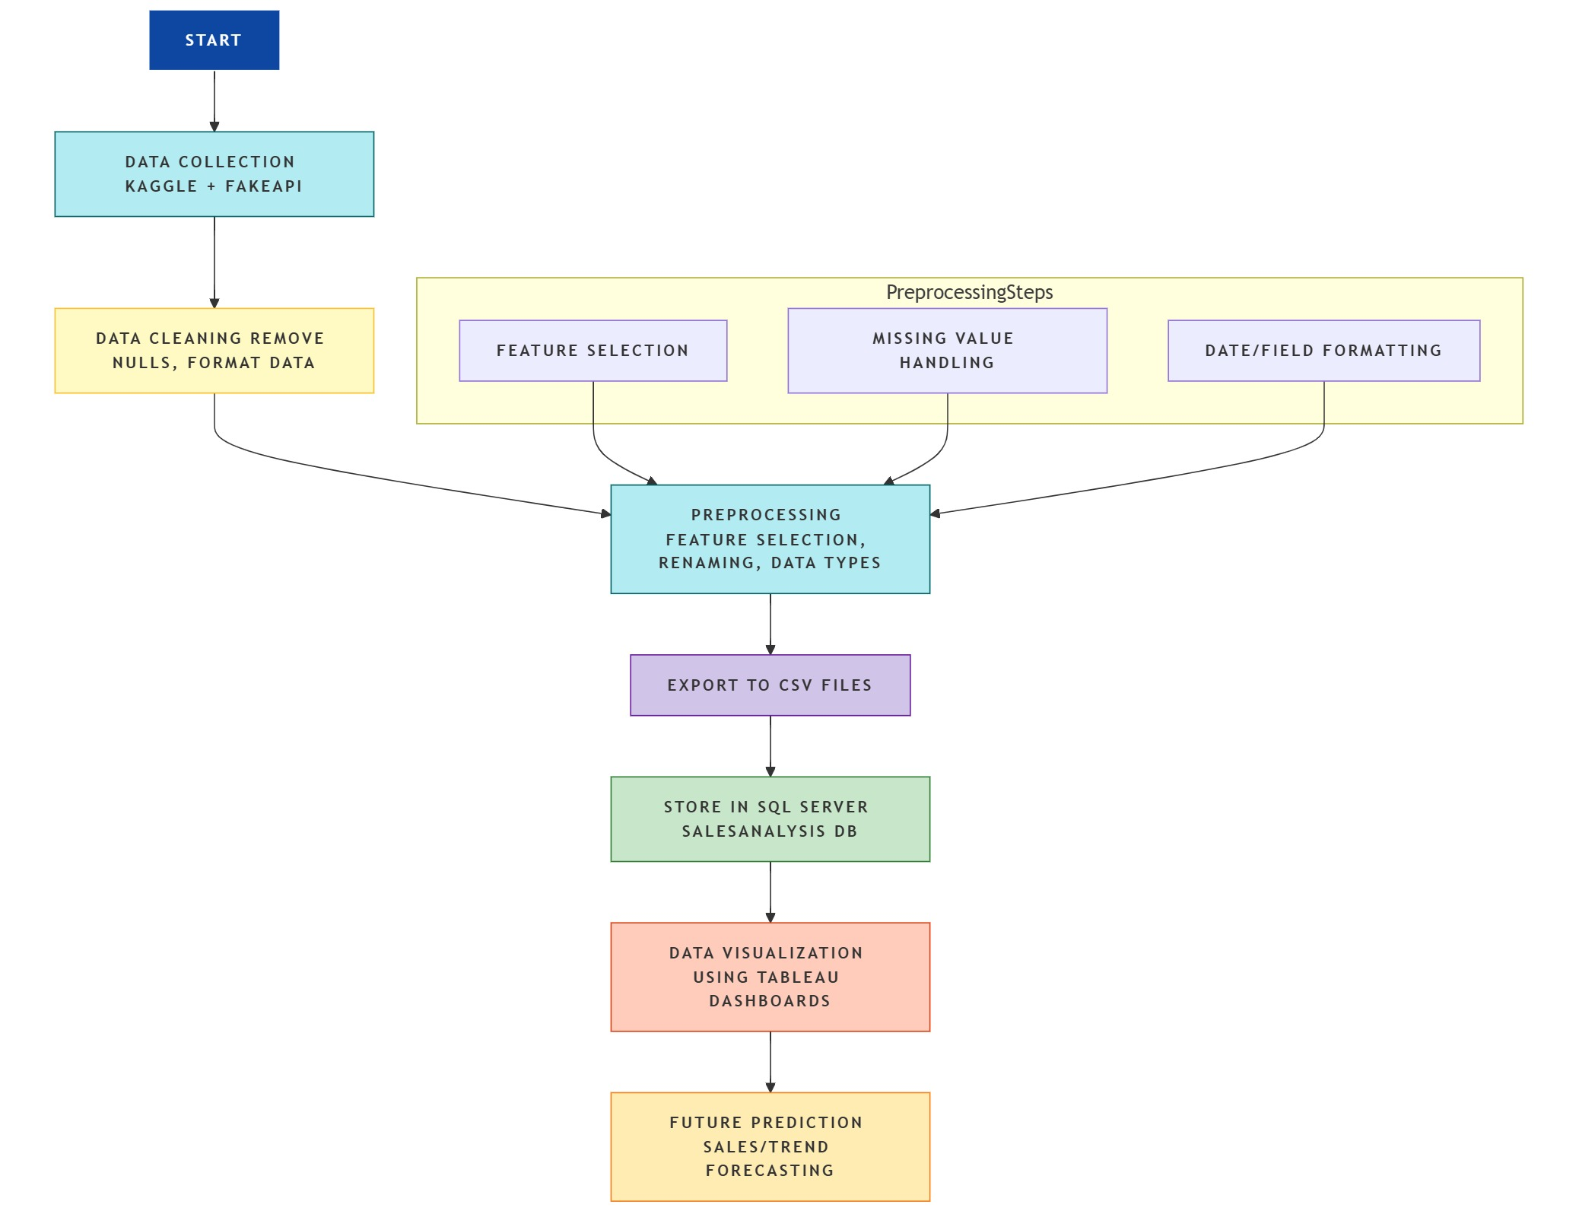
System Flow Diagram

Slide 8

Data Research and Integration
Title: Data Exploration & Integration
Kaggle Online Retail Dataset
(https://www.kaggle.com/datasets/carrie1/ecommerce-data) :
It contains historical sales records with customer ID, invoice number, product codes, quantity, price, date, and location.
Key Tables derived: Orders, OrderDetails, Customers, Products
FakeStoreAPI (https://fakestoreapi.com/products):
It used to enrich products with additional metadata: Category, Brand, Rating, and ImageURL.
This helps simulate a real-world catalog with diversified product types and associated attributes.

Slide 9

Data Collection
Title: Data Collection & Preprocessing
Cleaned and normalized flat CSV file from Kaggle.
Removed nulls, duplicates, and invalid entries.
API integration enriched products with additional metadata.
Used pandas for ETL and saved 5 normalized tables:
orders.csv, order_details.csv, customers.csv, products.csv, brands.csv

Slide 10
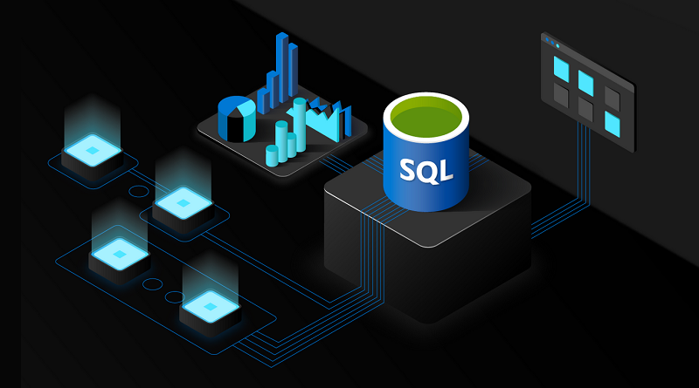
Data Storage and Maintenance
Title: Data Collection & Preprocessing
Database: Sales_Analysis
Created 5 relational tables with constraints and foreign keys.
Ensured data integrity, normalization, and indexing.
Python script automated data loading using pyodbc.
Backup, retention, and disaster recovery plans in place.

Slide 11

Data Quality
🔍 Exploration: Used .info(), .describe(), .value_counts() to identify missing values, outliers, and duplicates
🧹 Cleaning: Handled missing data using deletion and KNN imputation; resolved inconsistencies in text fields
🔄 Transformation: Normalized numerical data; encoded categories using one-hot encoding
✔️ Validation: Applied range checks (e.g., Rating 0–5), format rules, and ensured IDs match across tables
🔁 Cross-Checks: Compared sales data between Orders & OrderDetails for accuracy
📊 Tools Used: pandas, OpenRefine, Pyjanitor
📄 Metadata: Created data dictionary and documented data sources, variables, and transformations
📈 Governance: Set SLA targets (e.g., daily refresh, <5 min dashboard delay), logged ETL status, used fallback API handling
Title: Ensuring High Data Quality

Slide 12
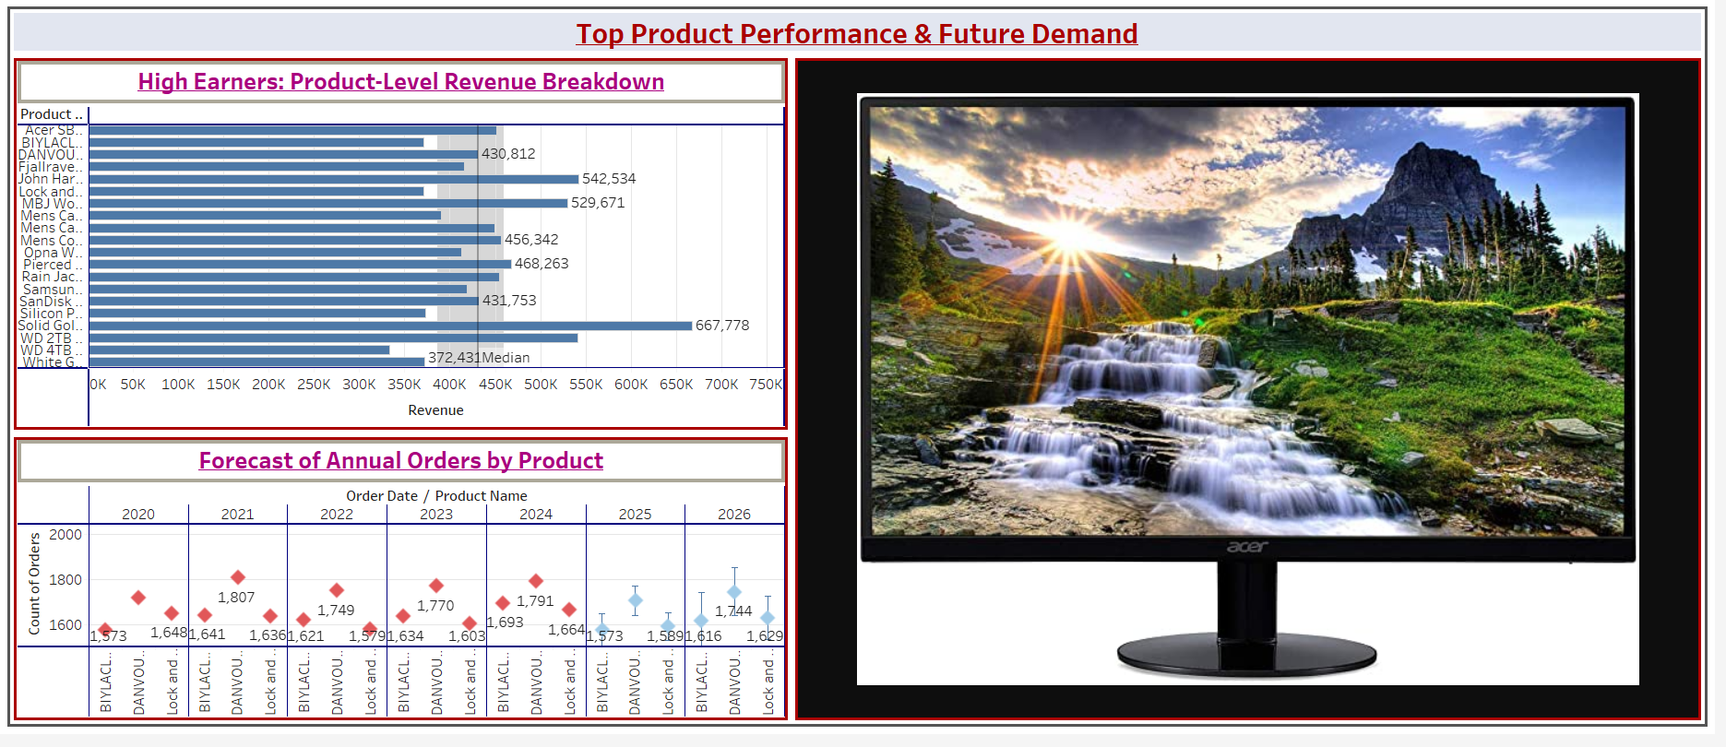
Data Analysis and Visualization
Title: Insights & Dashboards
SQL used to query structured data for KPIs.
Tableau/Power BI dashboard ideas:
Top products & brands
Sales by region and date
Customer segments & purchase frequency
Use cases: Marketing analysis, forecasting, sales optimization.

Slide 13
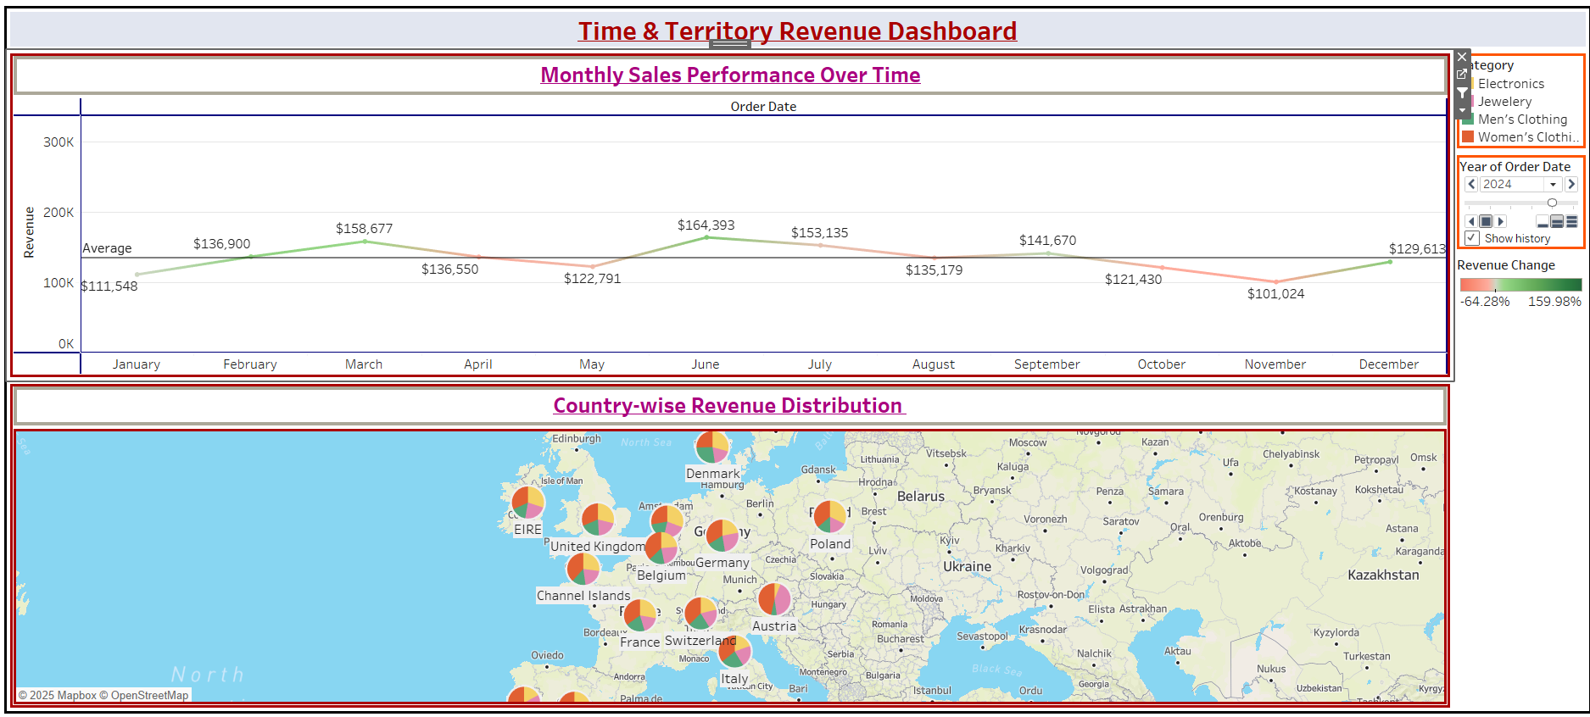
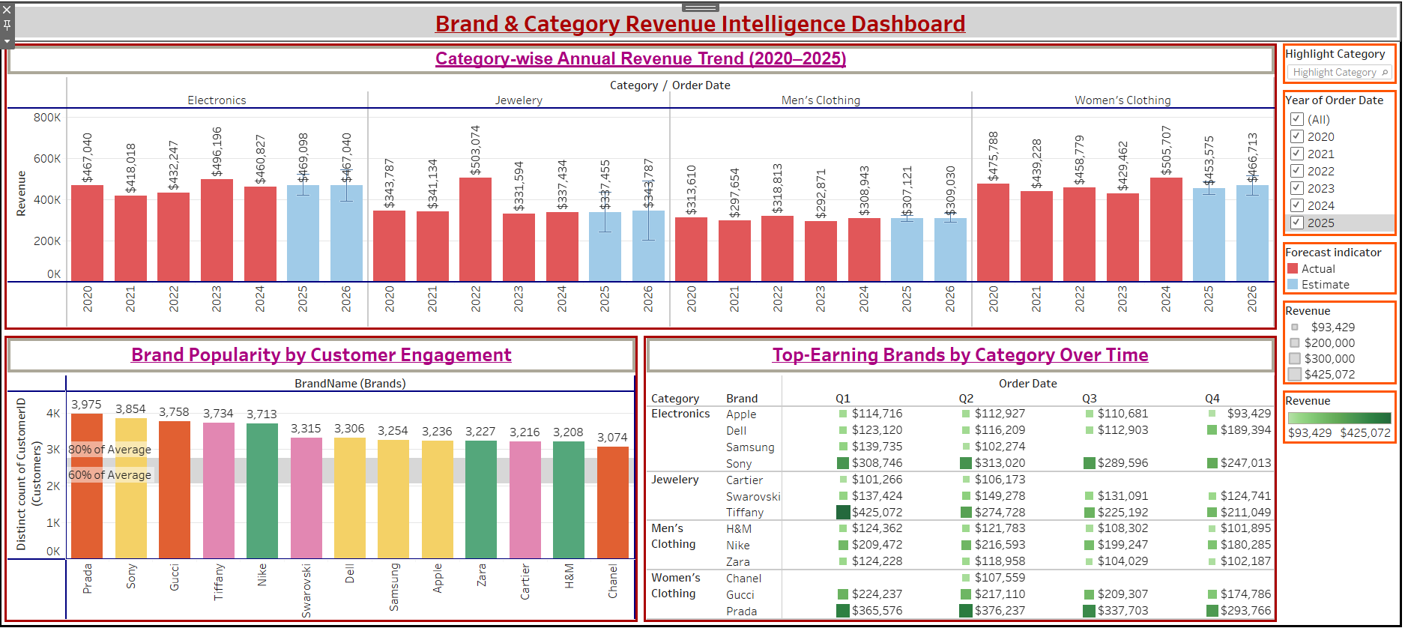
Revenue Dashboard
Time & Territory Revenue
Brand & Category
Revenue Intelligence

Slide 14
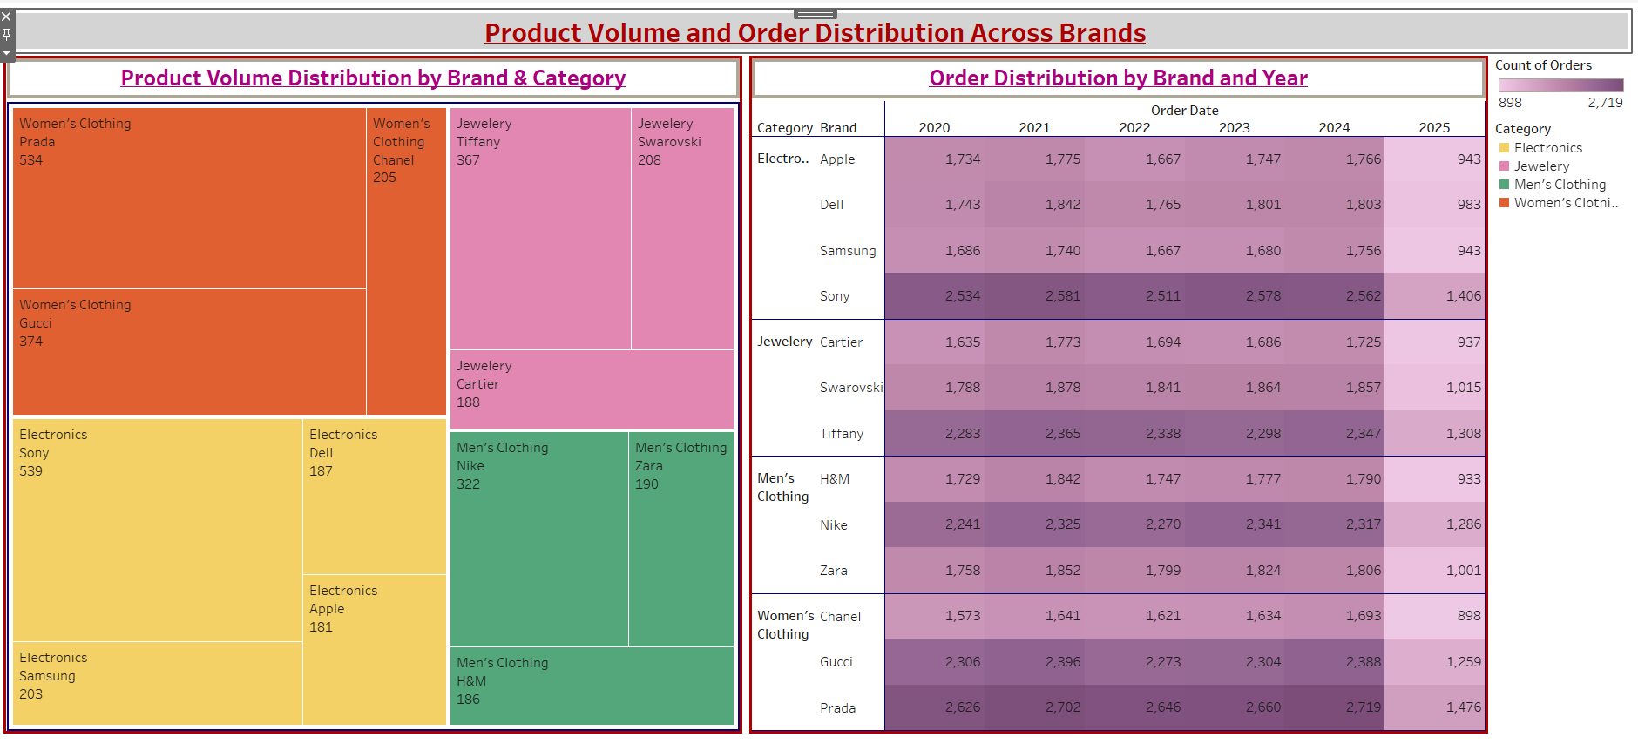
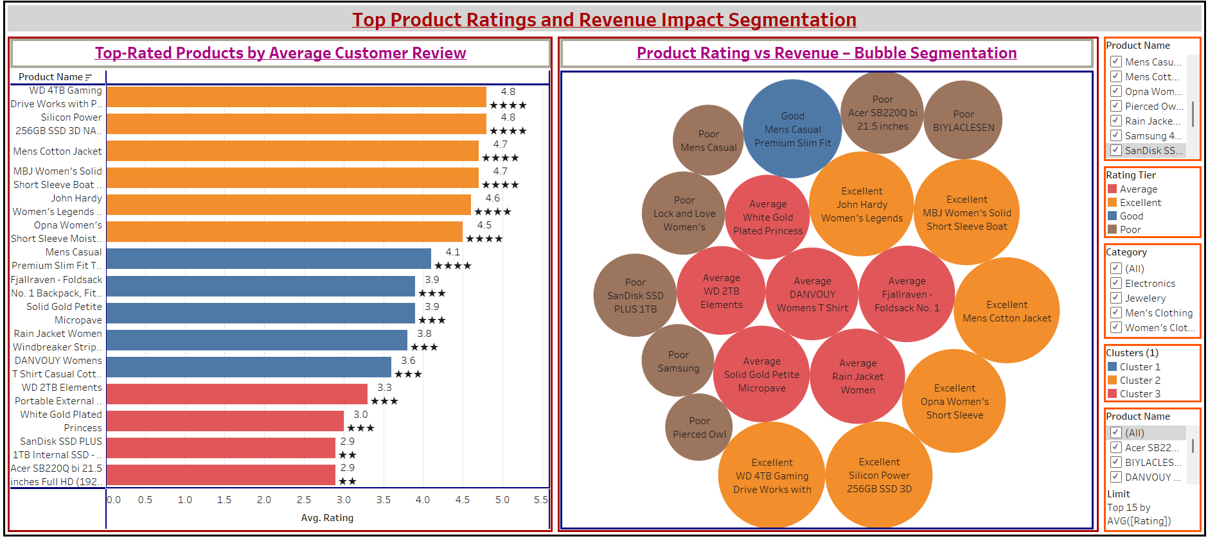
Top Product Ratings & Revenue Impact Segmentation
Product Volume & Order
Distribution Across Brands

Slide 15
Future Enhancement
Add real-time streaming via Kafka + Spark.
Integrate clickstream and cart abandonment data.
Build ML-based recommendation systems.
Cloud migration to GCP/Azure for scale.
Periodic data sync and monitoring via Airflow.

Slide 16
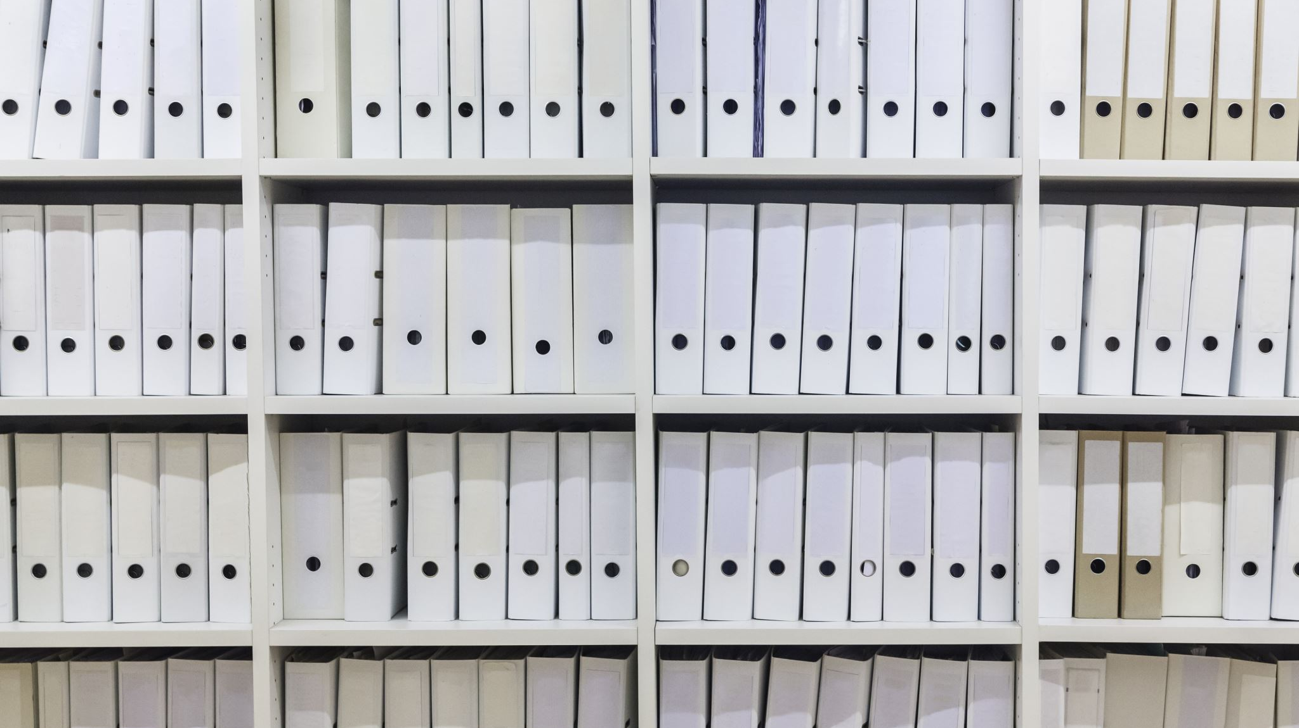
References
FakeStoreAPI. (n.d.). Fake Store API. https://fakestoreapi.com/
Kaggle. (n.d.). E-commerce data. Kaggle. https://www.kaggle.com/datasets/carrie1/ecommerce-data
Microsoft. (n.d.). SQL Server 2019 documentation. https://learn.microsoft.com/en-us/sql/sql-server/
Pandas Development Team. (2024). Pandas (v2.2.2) [Python library]. https://pandas.pydata.org/
NumPy Developers. (2024). NumPy (v1.26) [Python library]. https://numpy.org/
JetBrains. (n.d.). PyCharm: Python IDE for professional developers. https://www.jetbrains.com/pycharm/
Tableau Software. (n.d.). Tableau: Visual analytics platform. https://www.tableau.com/
Power BI. (n.d.). Business intelligence like never before. https://powerbi.microsoft.com/
OpenRefine. (n.d.). OpenRefine: A free, open source, powerful tool for working with messy data. https://openrefine.org/
CaptainVerify. (2021, April 22). Why is data quality important? CaptainVerify. https://captainverify.com/blog/importance-data-quality.html
Peipman, G. (2021, May 19). Using Azure Blob Storage to store MSSQL database files. gunnarpeipman.com. https://gunnarpeipman.com/mssql-files-on-azure-blob-storage/
Our Voices. (n.d.). Multiple types and ways of collecting data. Our Voices. https://ourvoicesou.co.uk/how-to-involve-children-and-young-people-in-research/3-involving-children-and-young-people-in-all-stages-of-research/multiple-types-and-ways-of-collecting-data/
Dibimbing. (2023, July 27). Apa itu data terintegrasi? Dibimbing. https://dibimbing.id/blog/detail/apa-itu-data-terintegrasi
GreenGeeks. (2019, November 8). 4 things you can't ignore when your eCommerce sales are down. GreenGeeks. https://www.greengeeks.com/blog/4-things-you-cant-ignore-when-your-ecommerce-sales-are-down/
BW Marketing World. (2023, October 20). Online retail sales surge 14% YoY; consumer electronics sales up by 60% in October: Report. BW Marketing World. https://www.bwmarketingworld.com/article/online-retail-sales-surge-14-yoy-consumer-electronics-sales-up-by-60-in-october-report-538964

Slide 17


